Slide 1
Group Policy Objects

Slide 2
01
TABLE OF CONTENTS
02
03
04
What is a GPO?
Structure, function, purpose
What uses a GPO?
Access, Retrieval
Changing GPOs
Modifying values of a GPO
Where to find GPOs
STIGs and the like

Slide 3
01
What is a GPO?
Structure, function, purpose

Slide 4
GPO -
GROUP POLICY OBJECT
A Group Policy Object (GPO) is a virtual collection of policy settings. A GPO has a unique name, such as a GUID.
Group Policy settings are contained in a GPO. A GPO can represent policy settings in the file system and in the Active Directory. GPO settings are evaluated by clients using the hierarchical nature of Active Directory.

Slide 5
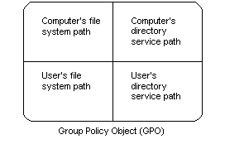
Structure of a GPO

Slide 6
WHAT DOES
GROUP POLICY DO?
POLICIES
ENFORCEMENT
Group policy is a collection of policies defined as registry keys and values. These keys and values are stored in a GPO, or group policy object, in a format that can be easily changed or transferred on different computers.
GPOs through Active Directory have the ability to change and modify policies of all computer on that network. The AD Domain Controller be polled and the appropriate settings will be enforced through the specified GPOs

Slide 7
A GPO’s OPERATION
ENFORCEMENT
INHERITANCE
FILTERING
Group Policy is processed in the following order:
LOCAL
SITE
DOMAIN
OU
Where a Group Policy Preference Settings is configured and there is also an equivalent Group Policy Setting configured, then the value of the Group Policy Setting will take precedence. This can be blocked or enforced for specific policies at each level
WMI filters allow administrators to apply the GPO only to, for example, computers of specific models, RAM, installed software, or anything available via WMI queries.

Slide 8
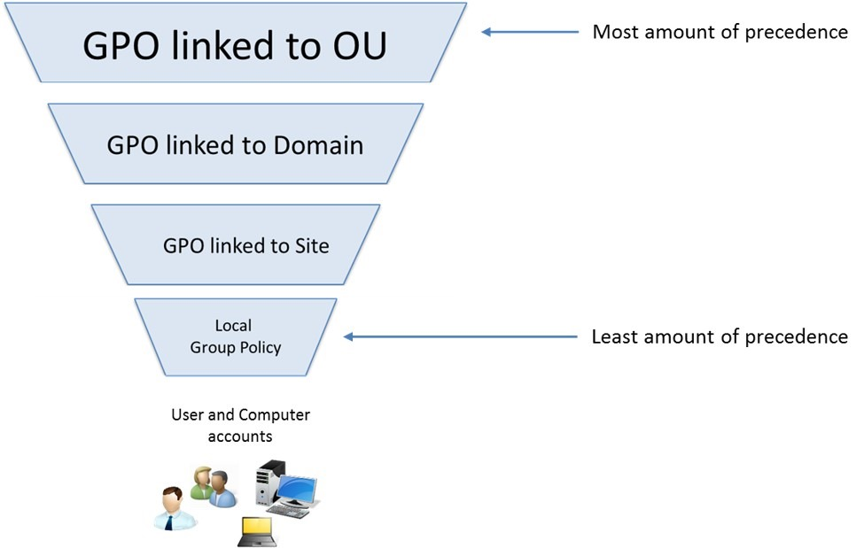
GPO Hierarchy

Slide 9
02
What uses
a GPO?
Access, Retrieval

Slide 10
THERE ARE 2 SEPARATE GUI METHODS OF ACCESSING GPOS
LOCAL GROUP POLICY CONSOLE
GROUP POLICY MANAGEMENT CONSOLE
The local group policy console is accessible on all Windows machines and manages the settings for the local-level group policy. These policy changes are at the lowest level and will be overridden by any higher-level policies
This console can be accessed through MMC or gpedit.msc
The group policy management console manages higher level GPOs and can send out GPOs to computers on the domain overriding any local policies if an overlap occurs.
This console can be accessed through MMC or gpmc.msc

Slide 11
COMMAND LINE METHODS
POWERSHELL
SECEDIT
REGISTRY
Powershell methods are only accessible on Active Directory workstation using the X-GPO set of commands.
In chapter 9, we briefly covered over secedit. Secedit is a command line tool that analyzes and determines security templates on the local computer. This does not analyze the complete LGPO though.
ALL changes to policies, regardless of level, will be reflected in a change in the registry. Edit and manipulate registry keys at your own risk.

Slide 12
Group Policy Module
(Get, New, Set, Remove, Copy) -GPO
Backup-GPO
Get-GPOReport
Does it’s respective tasks as seen before for a Group Policy Object
Backs up one or all GPOs on a domain
Generates a report either in XML or HTML format for a specified GPO or for all GPOs in a domain.
(Get, Remove, Set) -GPRegistryValue
Import-GPO
Invoke-GPUpdate
A GPRegistryValue is a value in the registry under the Computer Configuration or User Configuration in the GPO
Imports the Group Policy settings from a backed-up GPO into a specified GPO.
Schedules a remote Group Policy refresh on the specified computer.

Slide 13
LGPO.exe
An external application designed by Microsoft to easily import, export, and transfer GPOs to computers that are not on a domain.
https://www.microsoft.com/en-us/download/details.aspx?id=55319

Slide 14
03
CHANGING GPOs
03
Modifying values of a GPO

Slide 15
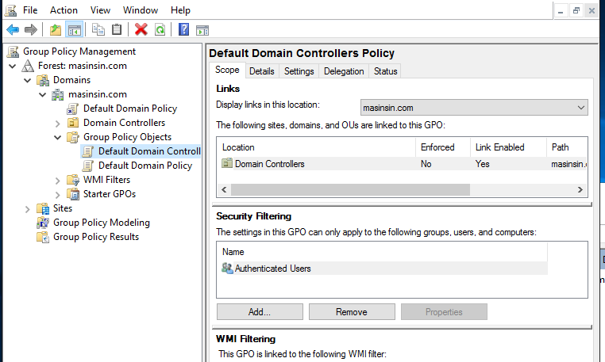
GROUP POLICY MANAGEMENT CONSOLE
Select a GPO from one on the domain and edit policies. You can also change whether the GPO is enforced or not.

Slide 16
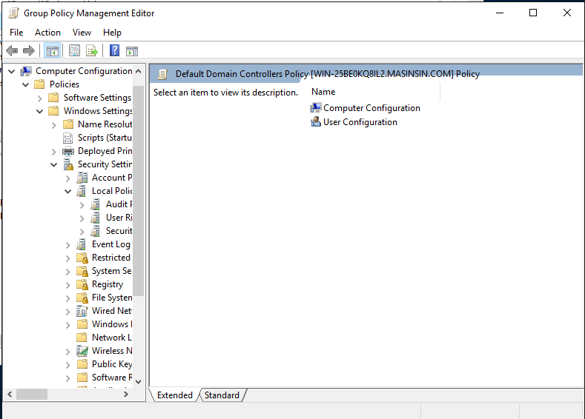
GROUP POLICY
Change and edit individual policy settings here.

Slide 17
04
Where to find GPOs
STIGs and the like

Slide 18
STIGs
Security Technical Implementation Guides or STIGs are guidelines to follow when creating security policies for your network

Slide 19
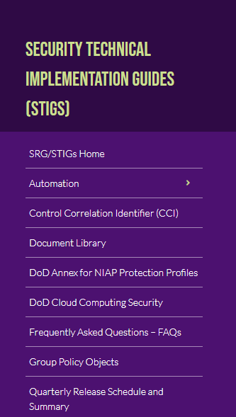
Department of Defense
The Department of Defense (DoD) has free pre implemented Group Policy STIGs that follow modern and up-to-date security policies.
https://public.cyber.mil/stigs/gpo/

Slide 20
THANKS!
Does anyone have any questions?

